Slide 1

Introduction and Implementation to Generative AI
M K Pavan Kumar

Slide 2
Agenda
1. Introduction
2. Embeddings
3. Playing with vector DB
4. Architectures of LLMs
5. LLMs and RAG
6. Run LLMs privately
7. Finetuning LLMs

Slide 3
What is NLP
NLP stands for Natural Language Processing. In short, it is a field of artificial intelligence (AI) that focuses on the interaction between computers and humans through natural language. NLP involves the development of algorithms and models that enable computers to understand, interpret, and generate human language in a way that is both meaningful and contextually relevant. It encompasses tasks such as language understanding, language generation, machine translation, sentiment analysis, and more. NLP plays a crucial role in applications like chatbots, virtual assistants, language translation, and text summarization.

Slide 4
What is AI and Generative AI
An interdisciplinary branch of computer science with the goal of developing systems that can mimic the intelligence levels exhibited by humans.
AI
Acquire knowledge from available data and generate predictions without the need for explicit programming.
ML
DL
Uses “artificial neural networks” to learn from data.
Sub-field of AI that focuses on generating new content such as:
• Images • Text • Audio/music • Video • Code
Generative
AI

Slide 5
Why Now ?
Large Datasets
Availability of large and diverse datasets
AI models learn patterns, correlations, and characteristics of large datasets
Pre-trained state-of-the-art models
Computational Power
Advancements in hardware; GPUs
Access to cloud computing
Open-source software, Hugging Face
Innovative Models
Generative Adversarial Networks (GANs)
Transformers Architecture
Reinforcement learning from human feedback (RLHF)

Slide 6
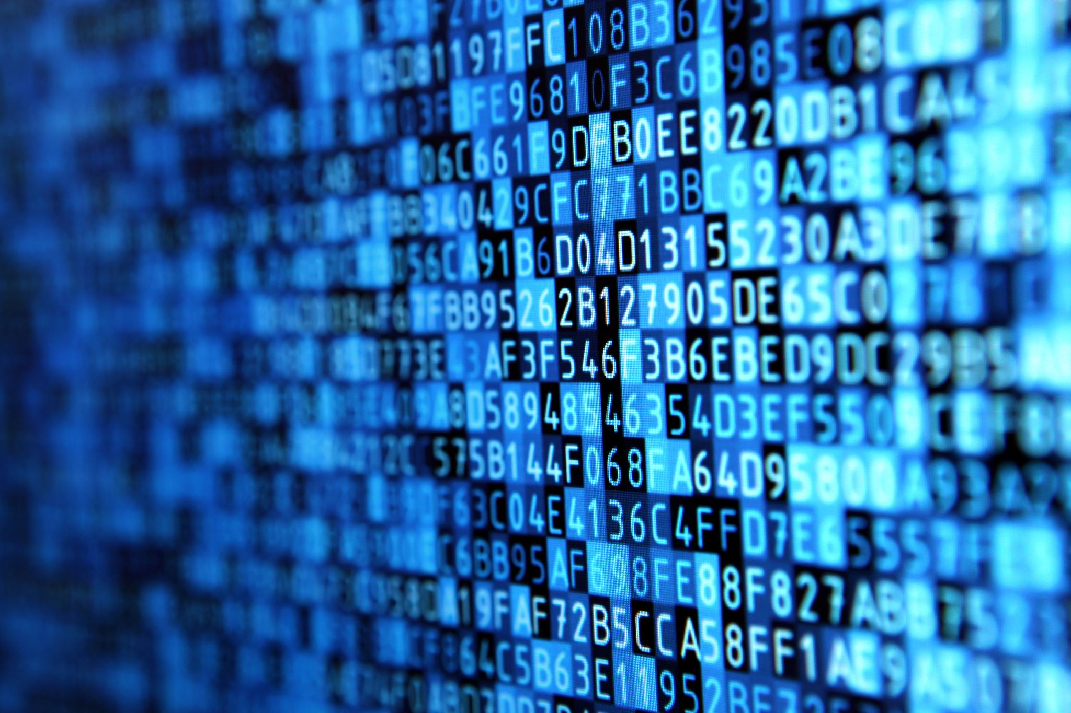
Natural Language Processing

Slide 7
Different Areas of usage ?
Translation
I love Data Science & Artificial Intelligence
我热爱数据科学与人工智能
Sequence to Sequence Generation
Sentiment Analysis
I saw a movie last week which is not so good
Negative
Sequence to Non Sequence Generation
Q and A
What is the efficiency score of Test Site of Customer X
Efficiency of Test Site of Customer X is 68%
Sequence to Sequence Generation

Slide 8
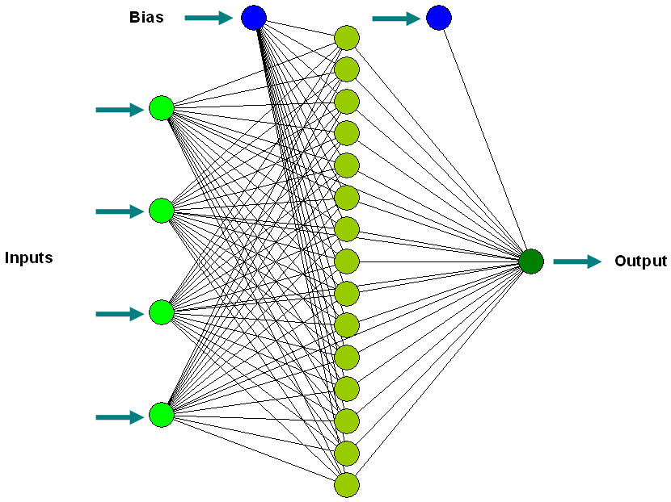

Different Areas of usage ? Contd..
A women standing in thick woods and capturing the scenic beauty of nature with her camera
Speech Recognition, Image Captioning, Image Generation

Slide 9

Practical Implementation

Slide 10
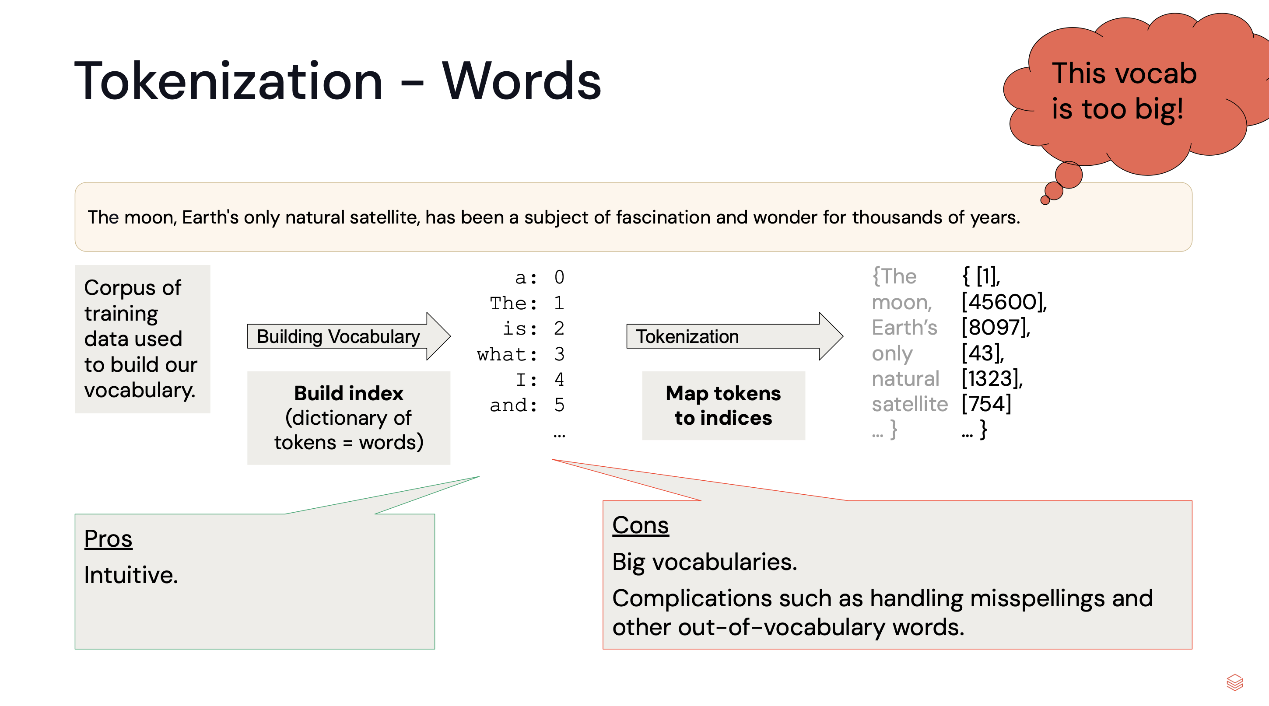
Tokenization Transforming Text to words – The First step in NLP

Slide 11
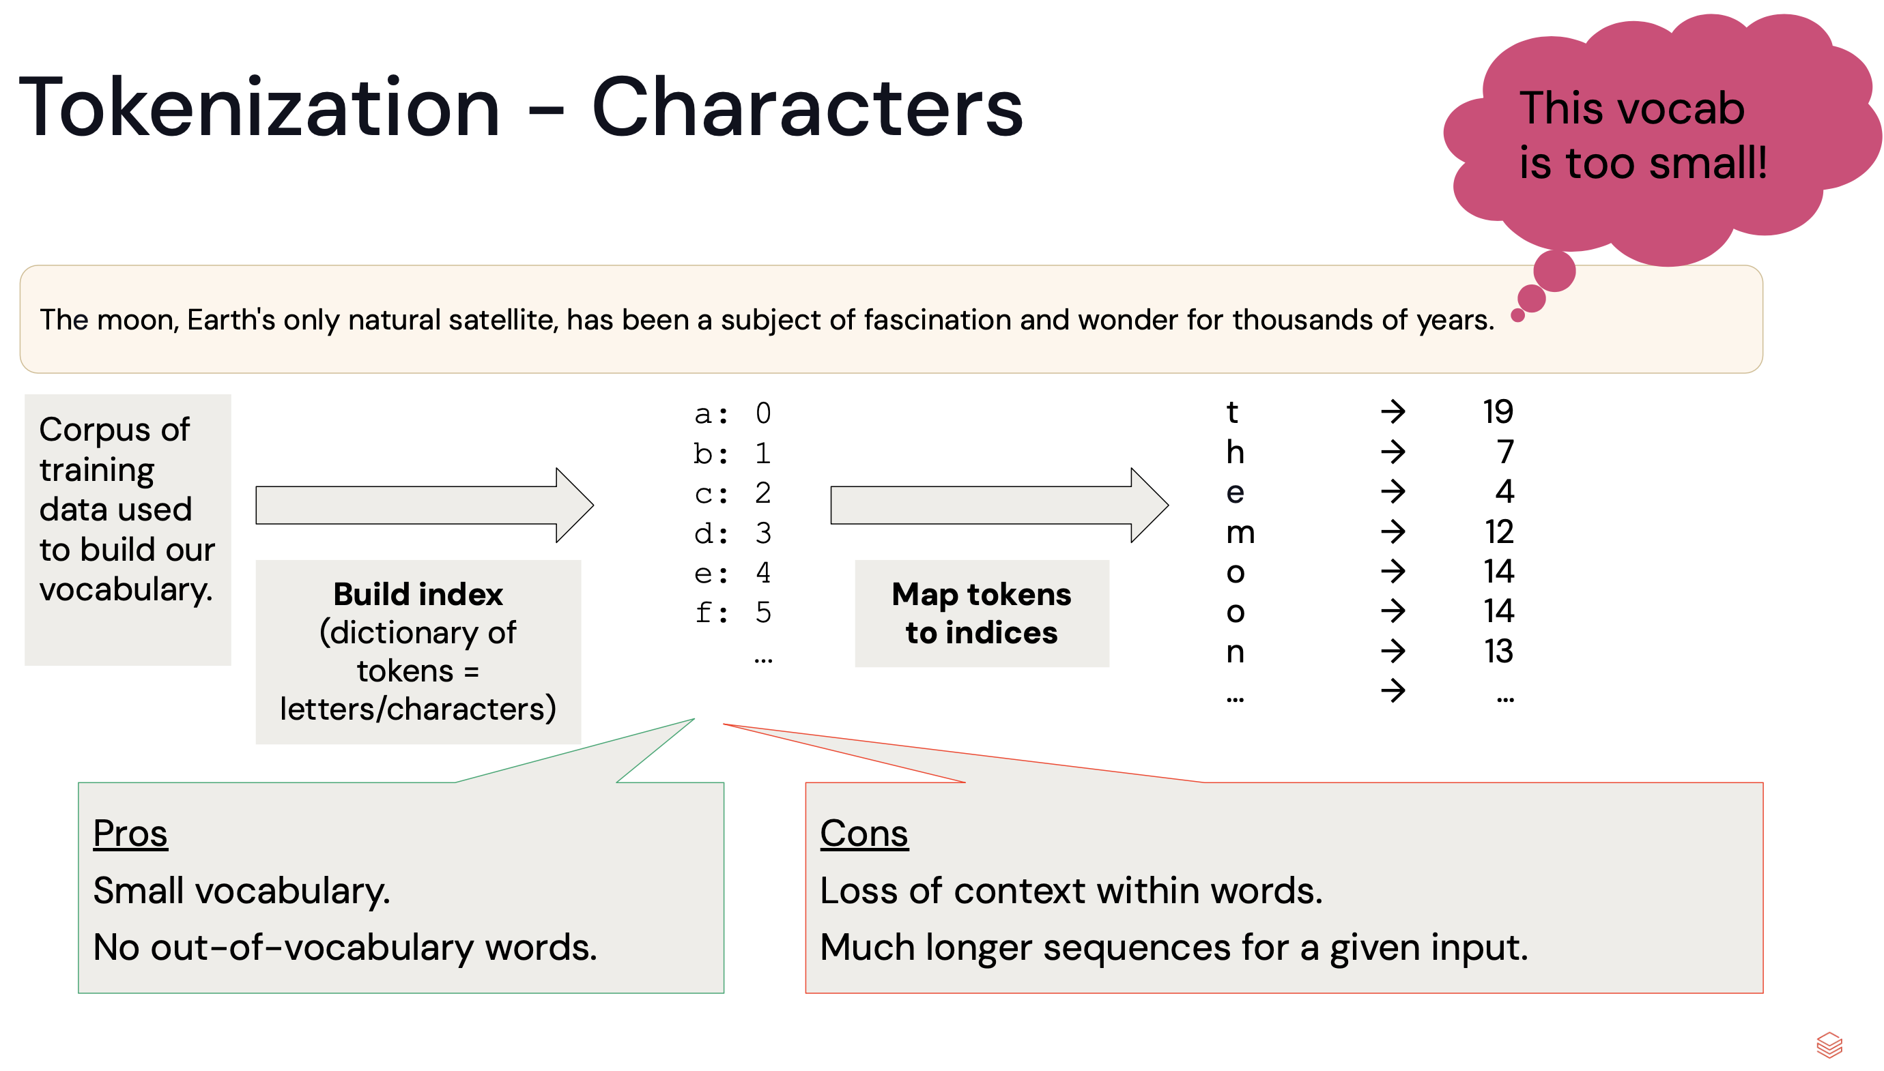
Tokenization Transforming Text to words – The First step in NLP

Slide 12
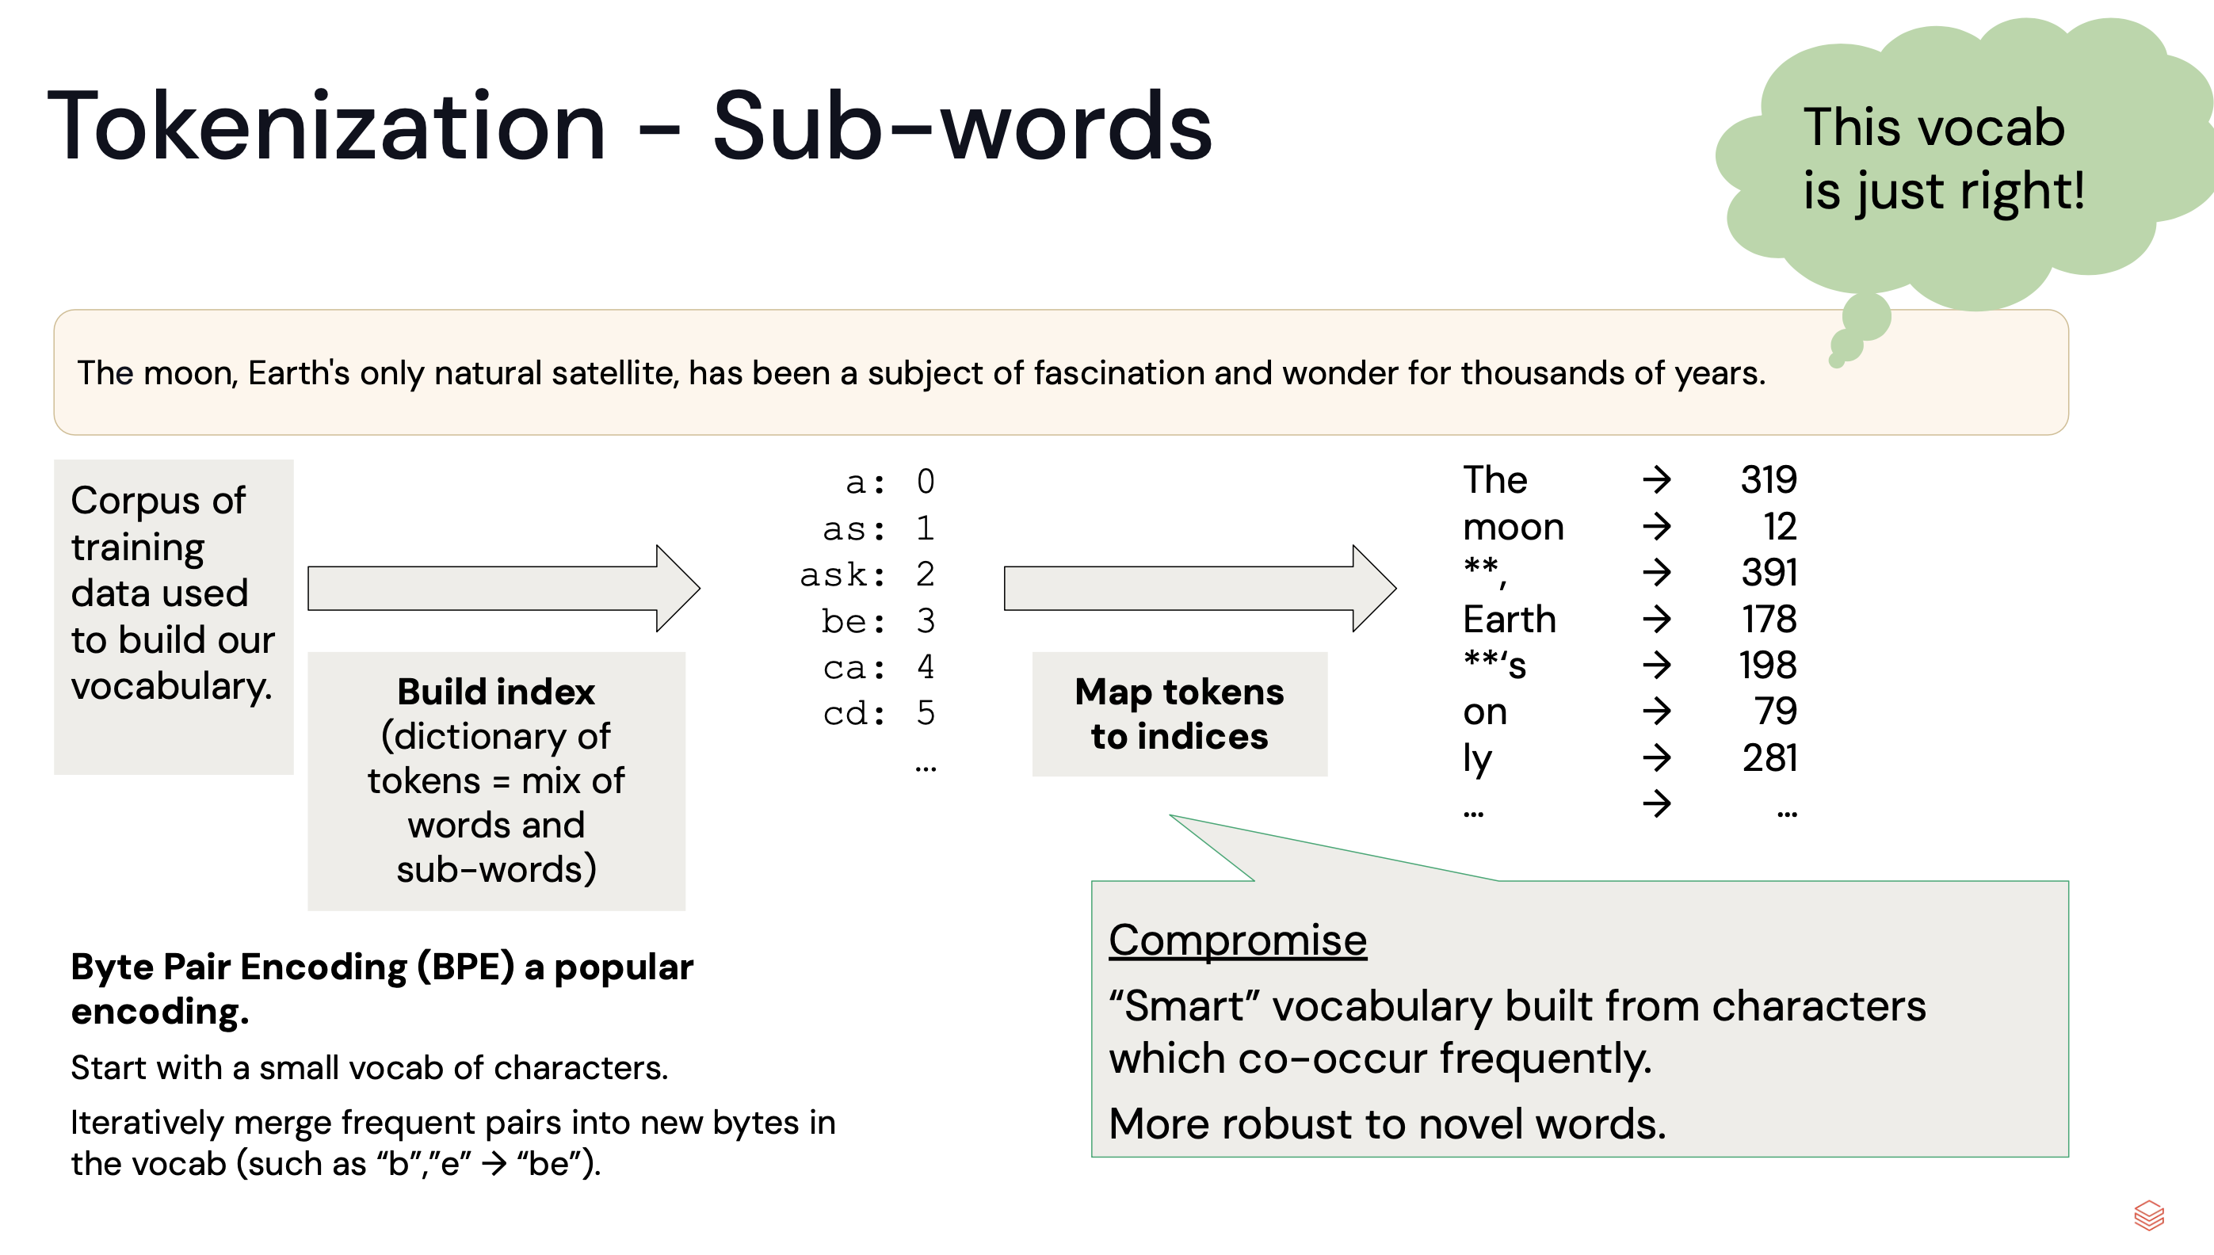
Tokenization Transforming Text to words – The First step in NLP

Slide 13

Word Embeddings Words that share the same contextual meaning
From wiki: Word embedding is the collective name for a set of language modeling and feature learning techniques in natural language processing (NLP) where words or phrases from the vocabulary are mapped to vectors of real numbers. The term word2vec literally translates to word to vector.
cat
“food” = [0.1548, 0.4848, …, 1.864]
“treat” = [0.8785, 0.8974, …, 2.794]
dog
treat
food
Word embeddings are created using a neural network with one input layer, one hidden layer and one output layer.

Slide 14
Practical Implementation

Slide 15
Introduction to Large Language Models (LLMs)

Slide 16
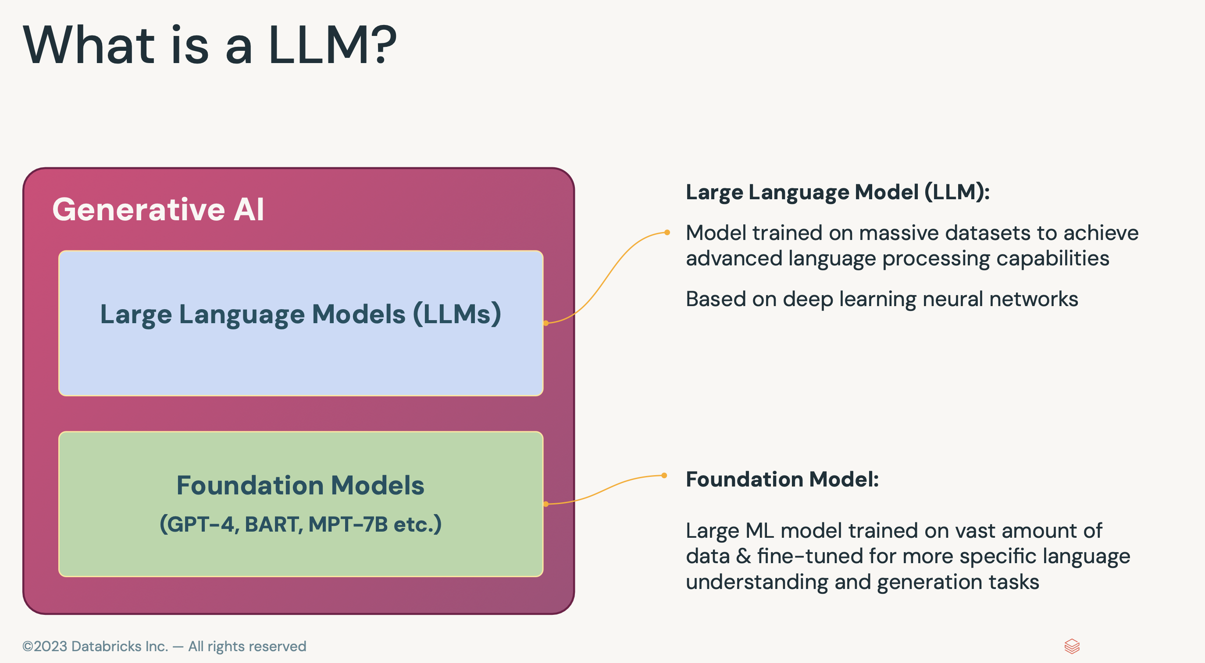
What is an LLM?

Slide 17
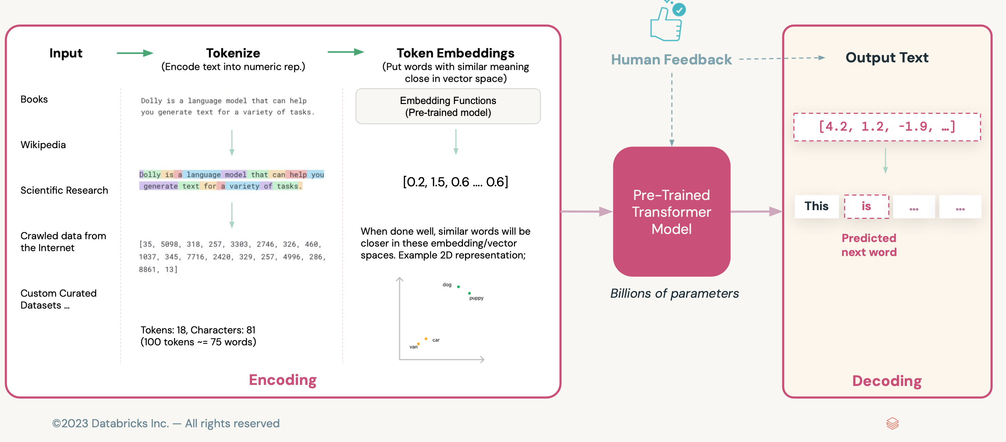
General Process of LLMs Training.

Slide 18
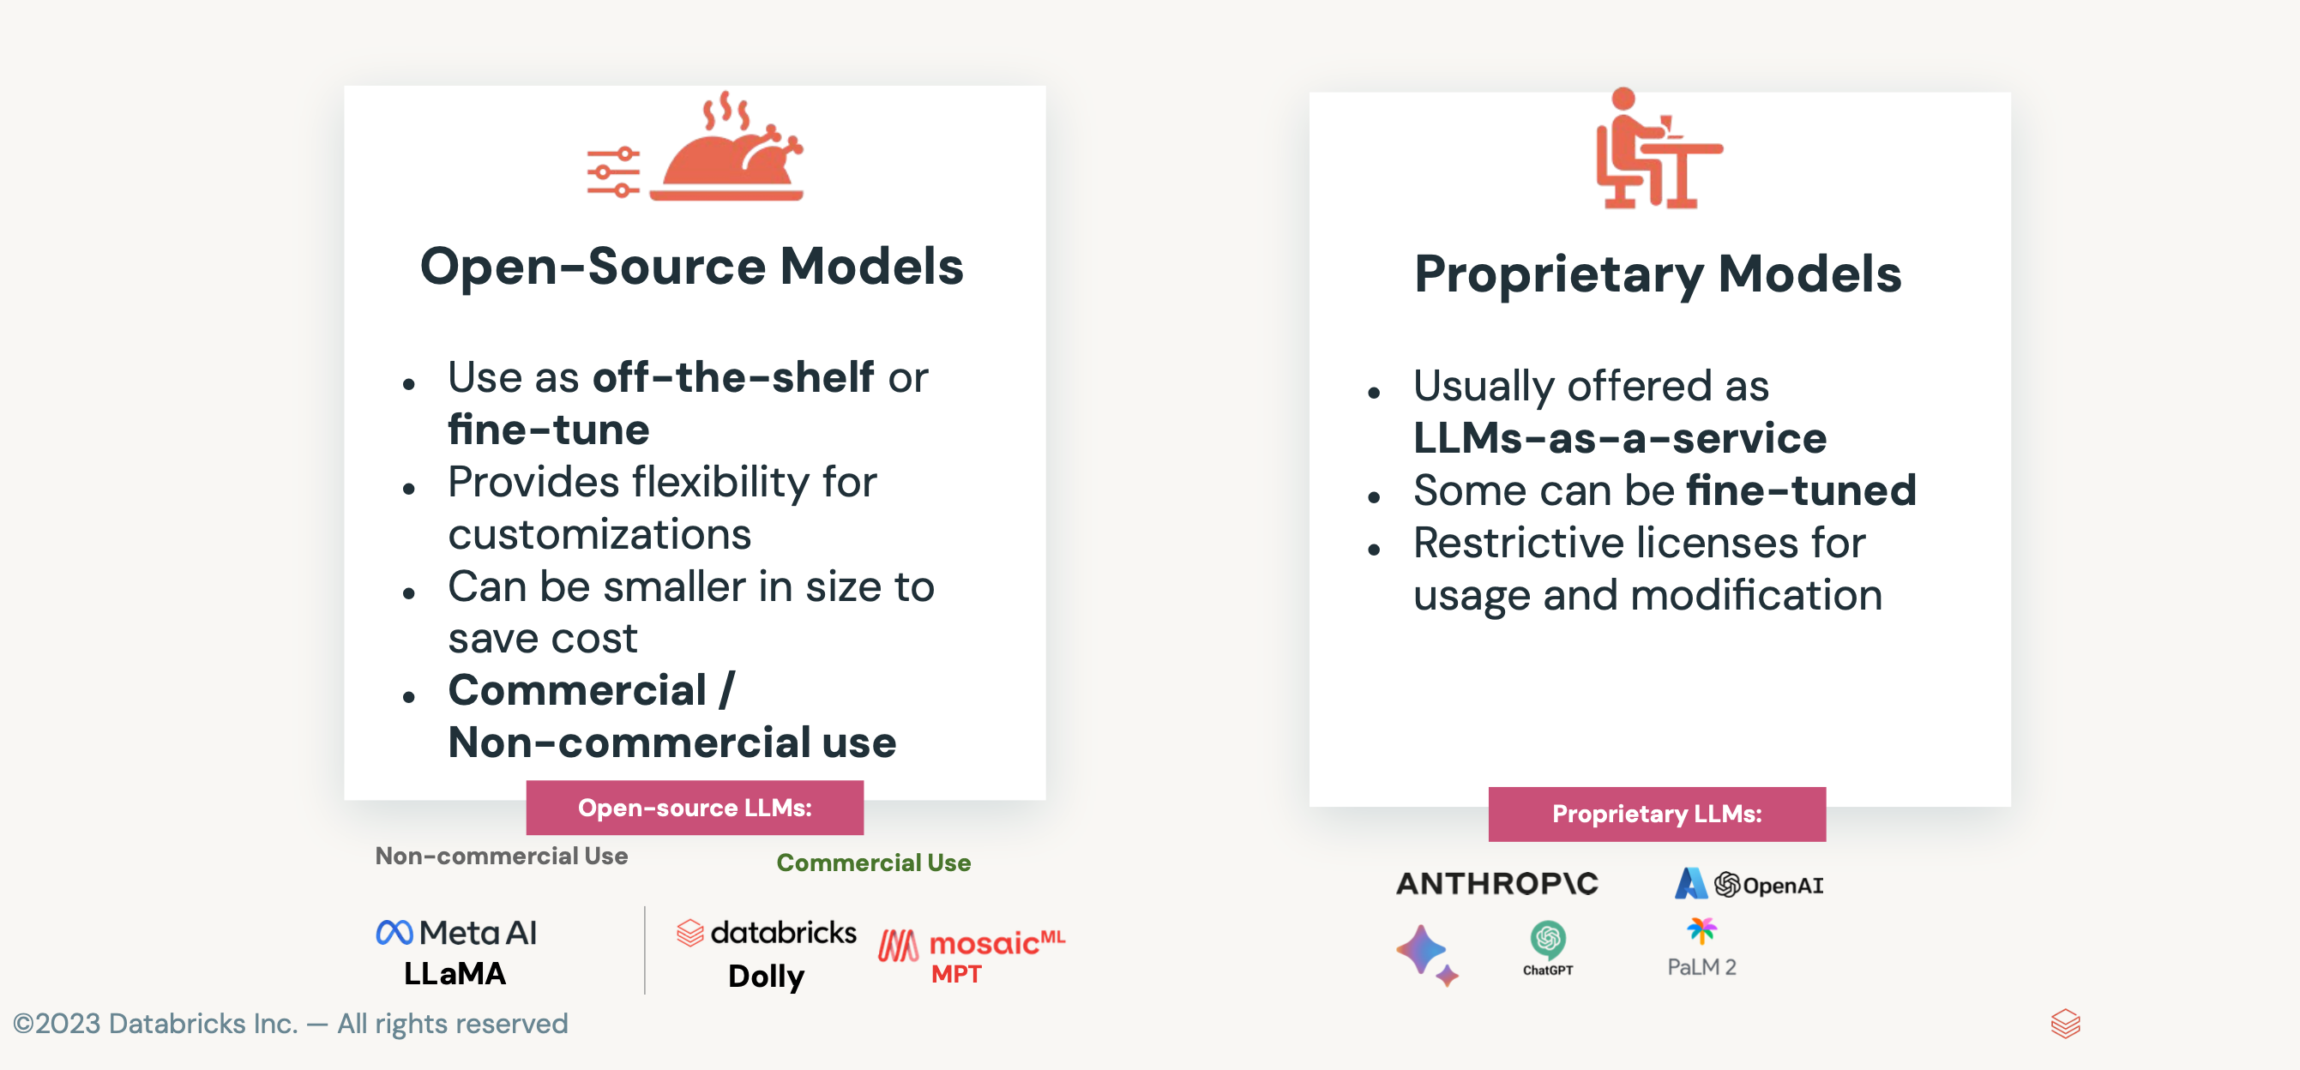
Types of LLMs

Slide 19




LLM model decision criteria
Privacy
Quality
Cost
Latency

Slide 20
LLMs Overview
Model or Model Family | Model Size (# Params) | License | Created By | Released
GPT-3 | 175B | Proprietary | OpenAI | 2020
GPT-4 | 100T | Proprietary | OpenAI | 2023
Mistral | 7B | Apache-2.0 | Mistral AI | 2023
BARD | 137B | Proprietary | Google AI | 2022
PaLM 2 (Bison-001) | 540B | Proprietary | Google AI | 2022
Claude v1 | 280B | Proprietary | Anthropic | 2023
Cohere | 125B | Proprietary | Cohere | 2021
LLaMA | 13B | Apache-2.0 | Meta AI | 2022
MPT-30B | 30B | Apache-2.0 | MosaicML | 2023

Slide 21
Common Tasks using LLMs
Icon | Feature | Description
📝 | Content Creation and Augmentation | Generate new text, add synonyms, paraphrase sentences
📑 | Summarization | Summarize long documents or articles
❓ | Question Answering | Answer questions by extracting information from pre-trained knowledge
🌐 | Machine Translation | Translate text from one language to another
📁 | Classification | Classify text into predefined classes or topics
🏷️ | Named Entity Recognition (NER) | Identify and extract named entities from text
⚖️ | Tone / Level of content | Adjust the tone (professional, humorous, etc.) or complexity level of text
💻 | Code generation | Generate code in a specified programming language
💬 | Generating coherent and contextually relevant text | Creative writing, story generation, dialogue generation

Slide 22
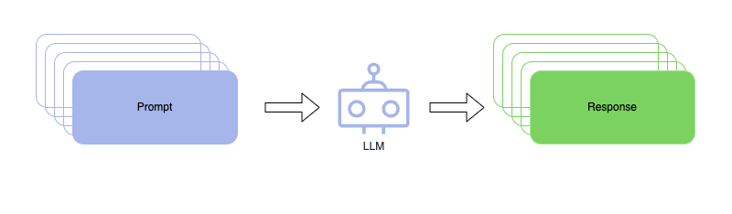
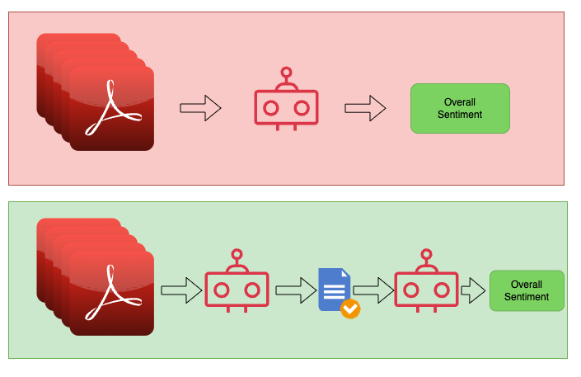
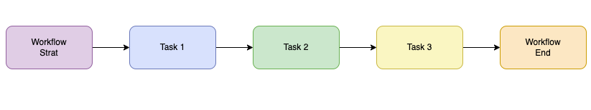
LLMs and Their workflows

Slide 23



Building LLMs The Three Phases of Learning
Pretraining
Finetuning
Prompting
Learn from the text
Learn general instructions
How to perform a task

Slide 24
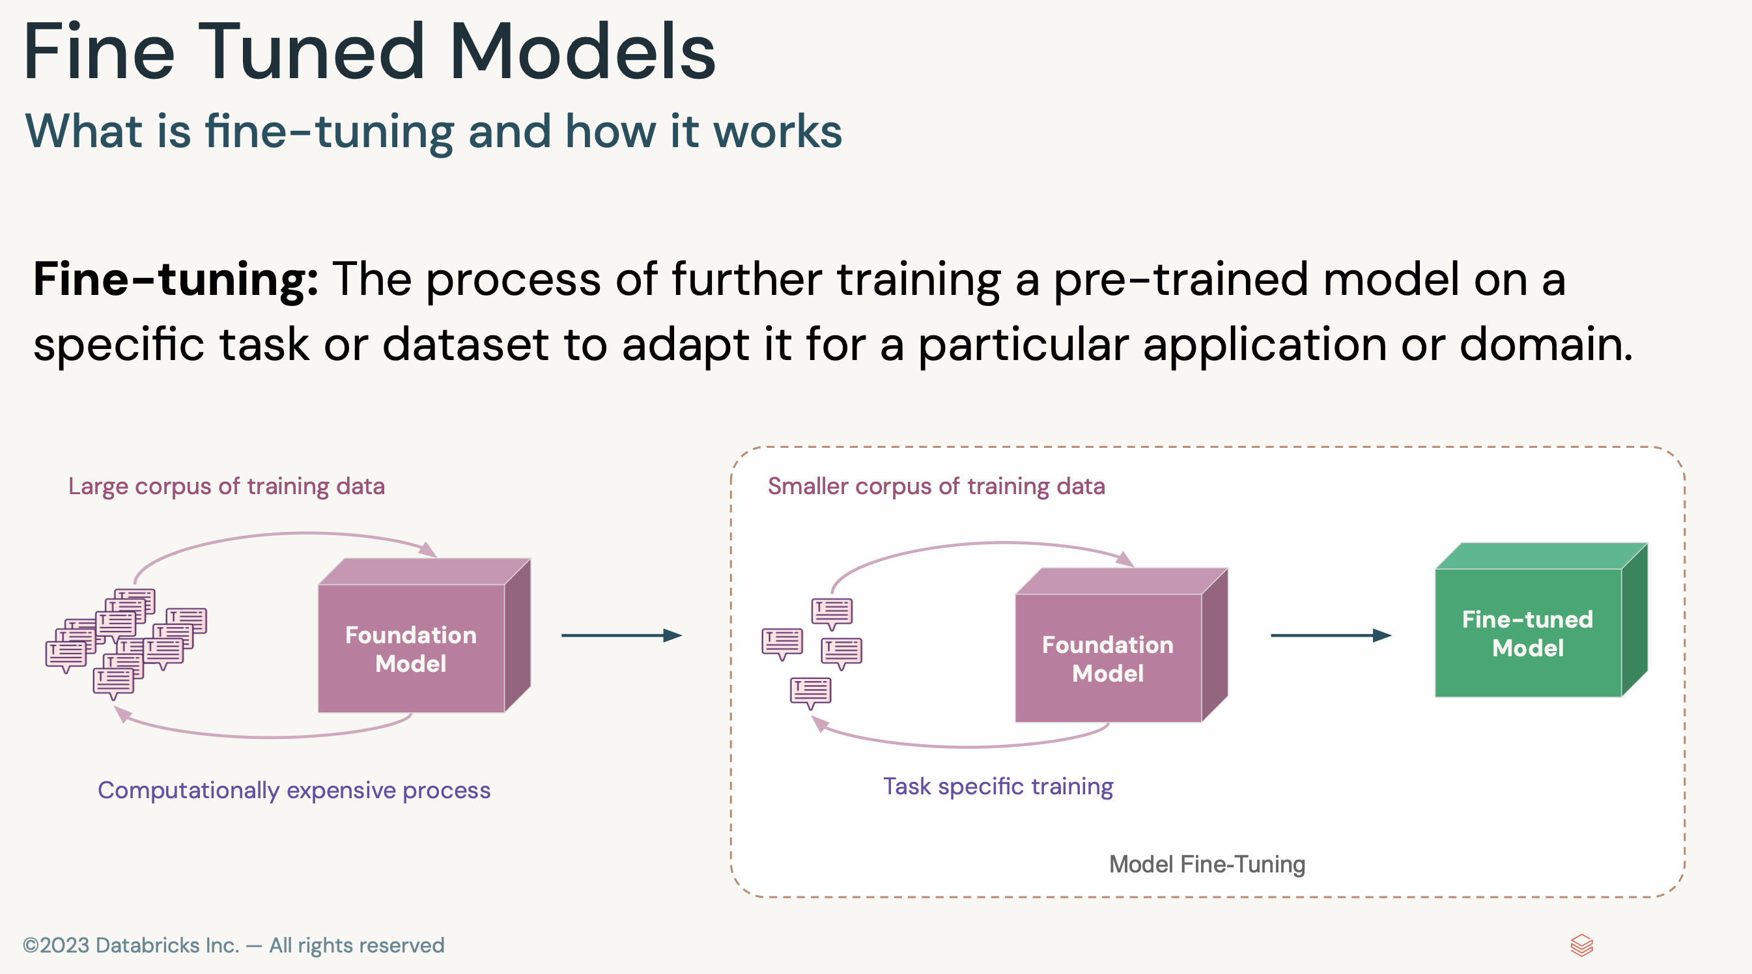
Fine Tuning Models

Slide 25
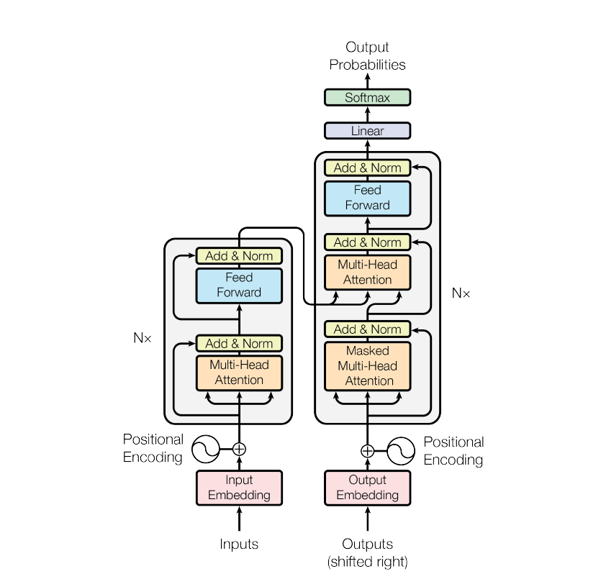
What are Transformers ?

Slide 26
X₃
Q
BERT, GPT, LLaMA, BARD
X₁
Query
_{key1}
X₂
K
_{key2}
X₃
_{key1}
Scores
Values
_{key3}
X₄
_{key2}
_{key1}
Query
_{A1}
_{v1}
y0
_{key4}
Query
Attention Score
_{key3}
_{key2}
Query
_{A2}
_{v2}
_{key4}
_{key3}
_{A3}
_{v3}
_{key4}
Query
_{A4}
_{y4}
X₁
_{y1}
X₂
_{y2}
y0
V
Model Prams
Q, K, V
X₃
_{y3}
X₄
_{y4}
Self attention
On
The
Banks
River
Ganga
On
The
Banks
River
Ganga
Query
Query
(X₁)
Keys
Keys

Slide 27
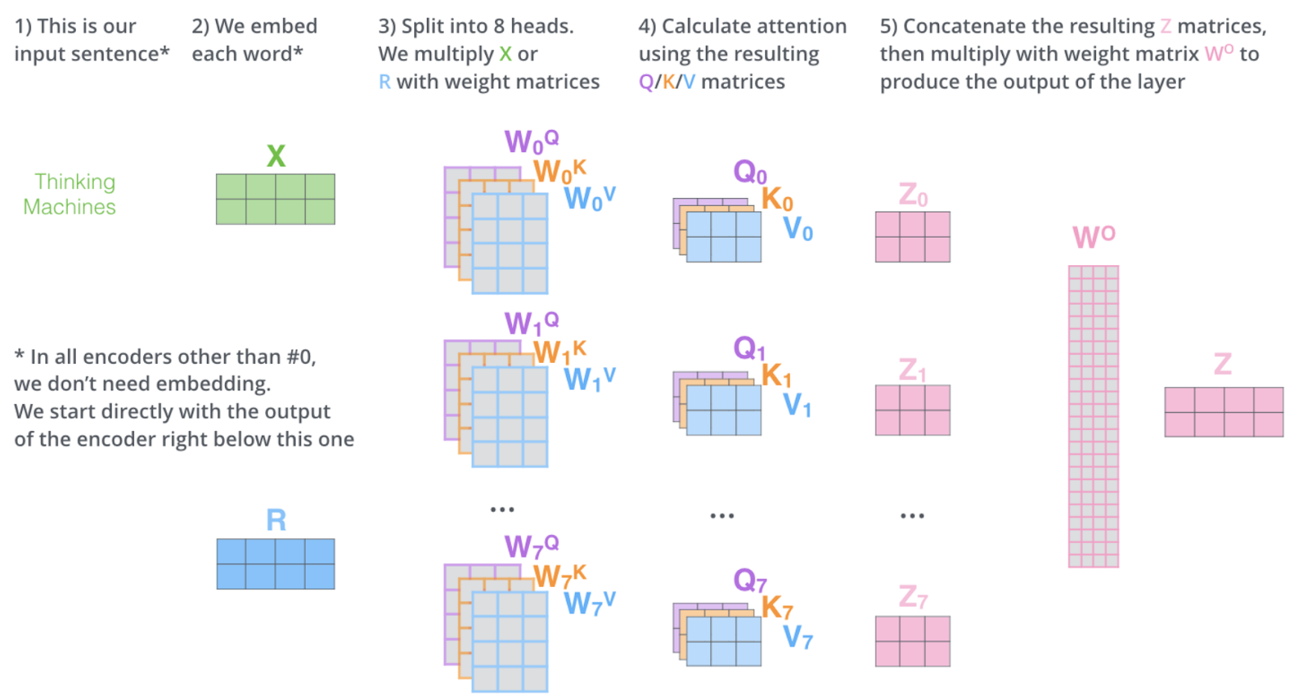
Attention Mechanisms contd…

Slide 28
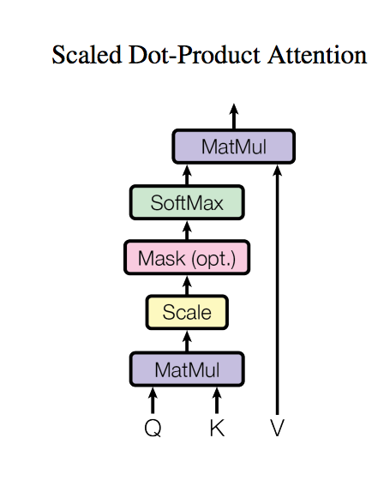
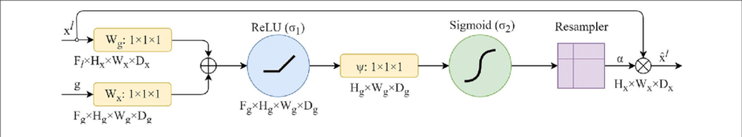
What are different types of Attention Mechanisms available ?
Additive Attention

Slide 29
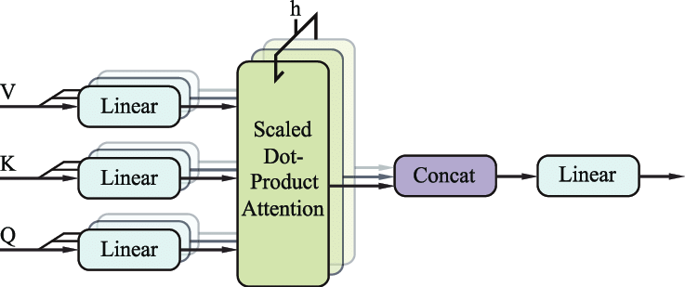
Multi-Head Attention Model

Slide 30
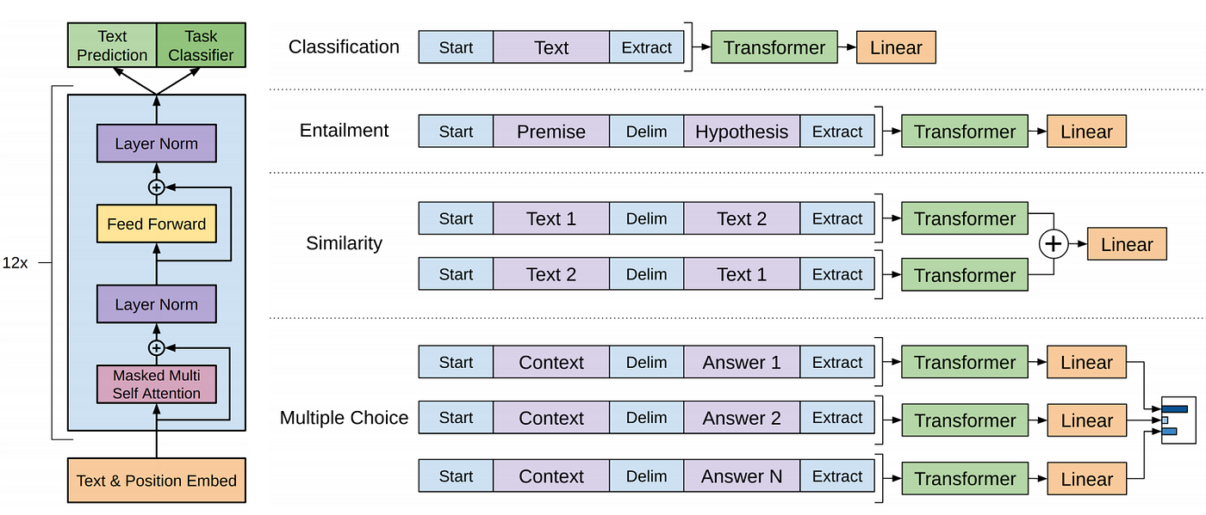
How ChatGPT Works ?

Slide 31
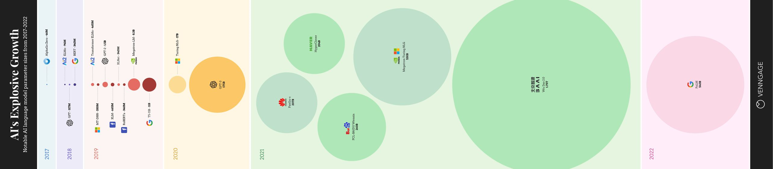
Evolution of LLMs

Slide 32
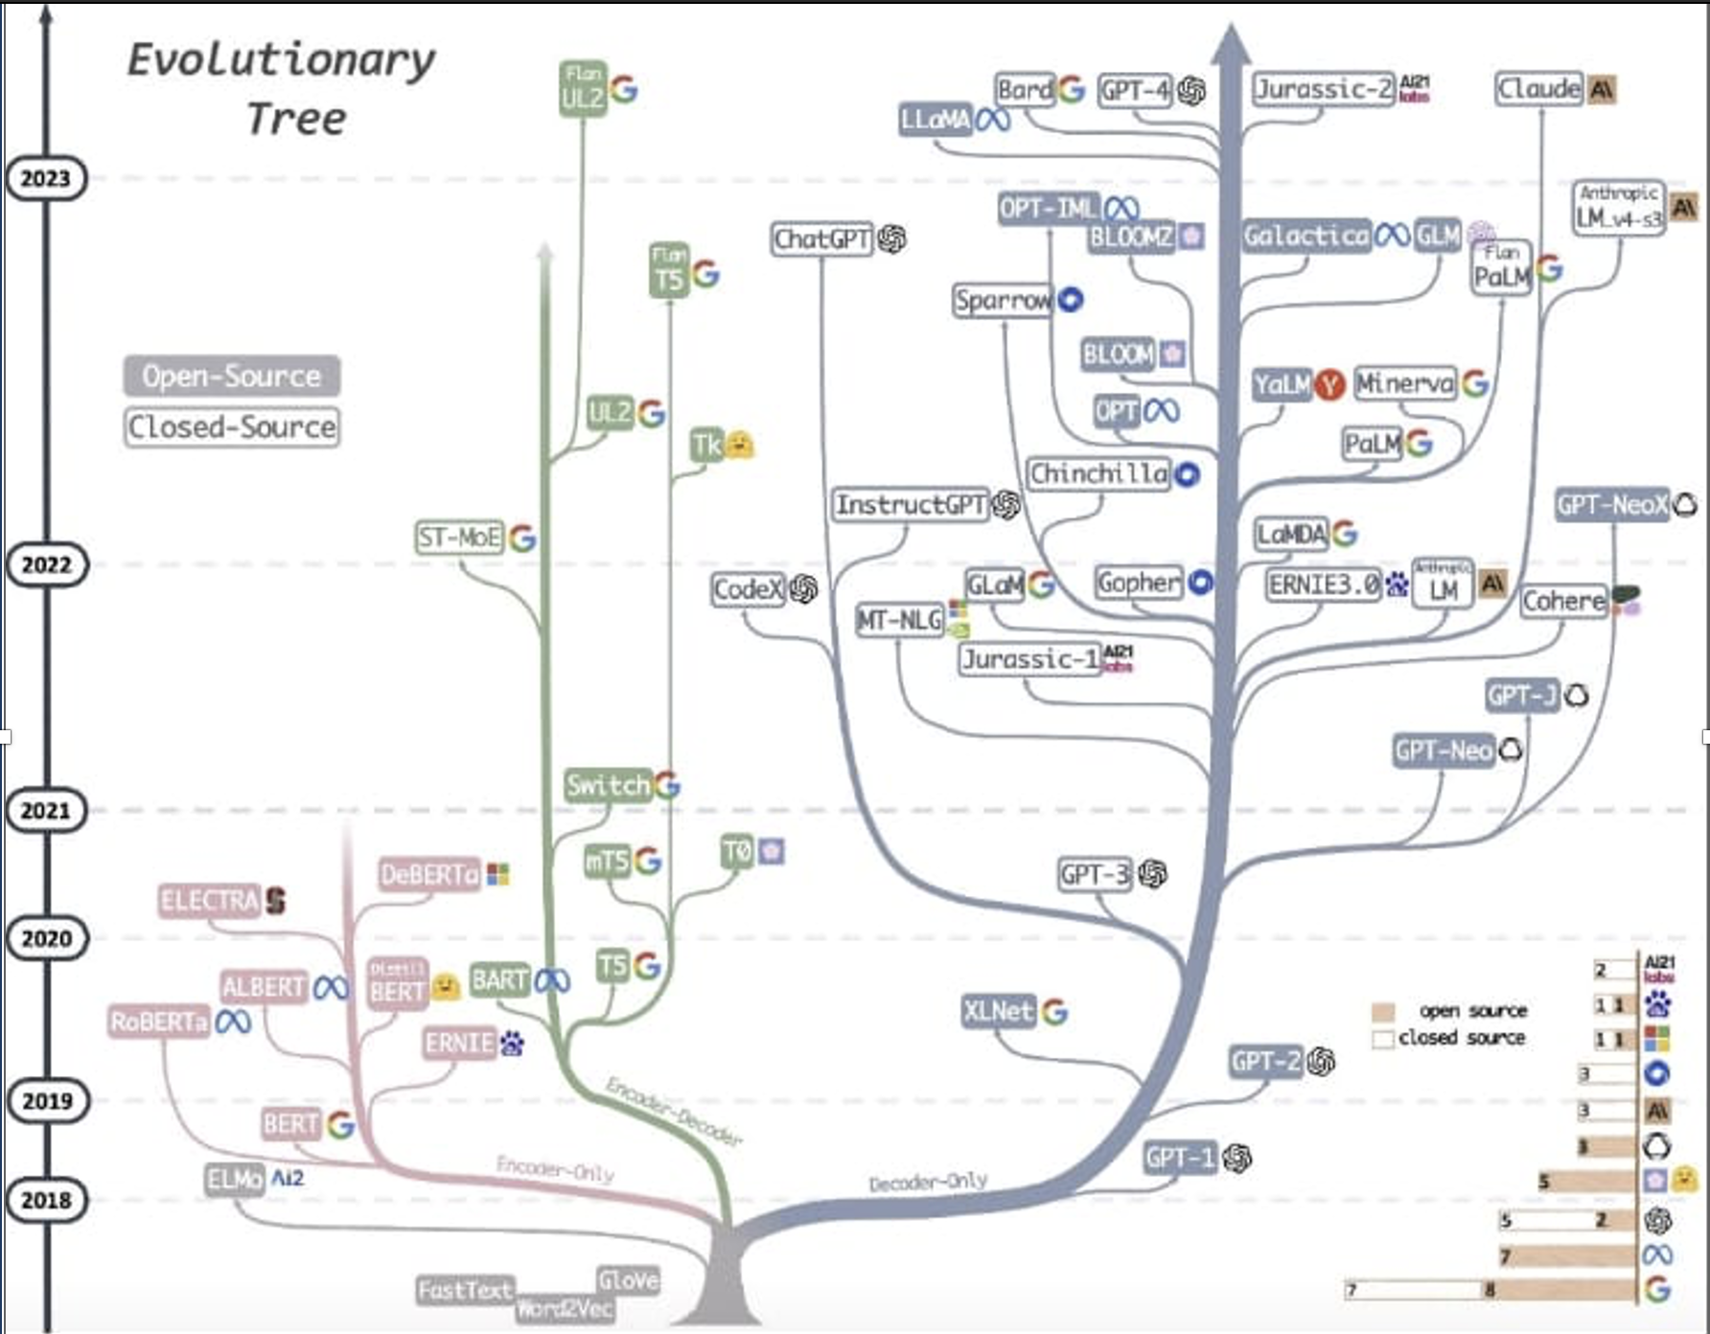

Slide 33
Prompting

Slide 34
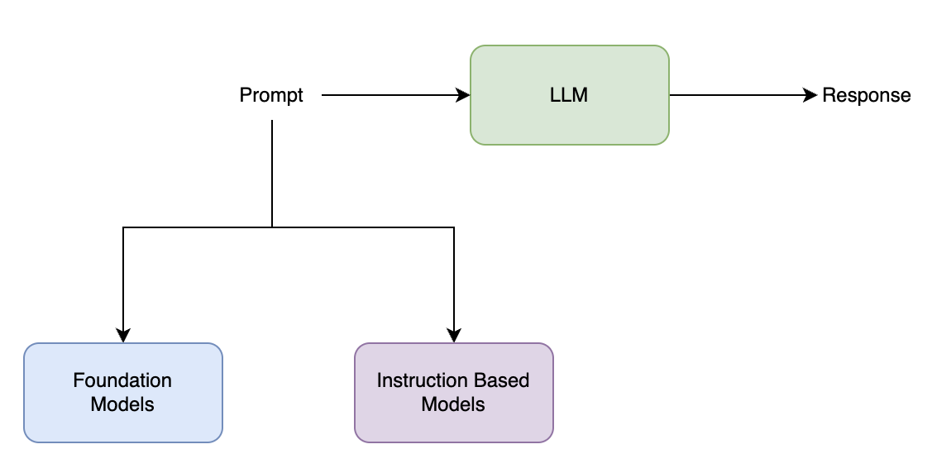
Prompts
Prompts are inputs or queries to LLMs to get specific response
A good prompt usually consists of:
Instruction
Context
Input / question
Output type / format
Describe the high-level task with clear commands
Use specific keywords: “Classify”, “Translate”, “Summarize”, “Extract”, ...
Include detailed instructions
Test different variations of the prompt across different samples
Which prompt does a better job on average?

Slide 35
Prompt Formatting Techniques
• Use delimiters to distinguish between instruction and context
• Pound sign ###
• Backticks ``` • Braces / brackets {} / []
• Dashes ---
• Ask the model to return structured output
• HTML, json, table, markdown, etc.
• Provide a correct example • "Return the movie name mentioned in the form of
a Python dictionary. The output should look like {'Title': 'In and Out'}"
Source: Databricks LLM Workshop

Slide 36
Practical Implementation

Slide 37
Vector Databases

Slide 38
Dense Vector Representation
Given a sentence, let’s transform that into dense vector representation of each token/word and store it for further analysis
Typical Dimensions
768, 1024, 4096
Data Science
Embedding
Function
[0.2,0.8,1.2,3.5,2.6,….1.9]
Word/Token
Pretrained Models
(Word2Vec / Huggingface)
Vector/Embeddings

Slide 39
Vector Similarity
Distance Metrics
Similarity Metrics
Manhattan Distance
Euclidean Distance
10º
Cos(10º) = 0.984 => 98% similar
The smaller the angle or Higher the metric, the more similar the vectors are
Higher the metric, the less similar the vectors are

Slide 40
Different Vector Databases
Chroma DB
Milvus DB
Pinecone DB
Faiss DB
MongoDB Vector Store
Redis Vector Store
PostgreSQL Vector Store

Slide 41
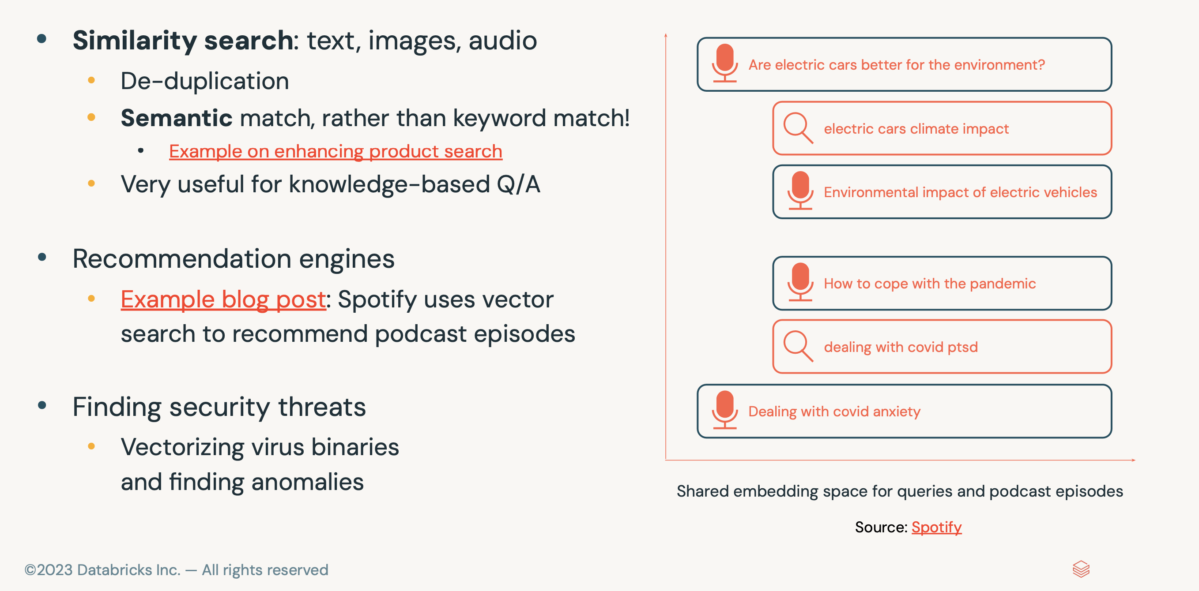
Use cases of Vector Databases

Slide 42
Retrieval Augmented Generation
(RAG)

Slide 43
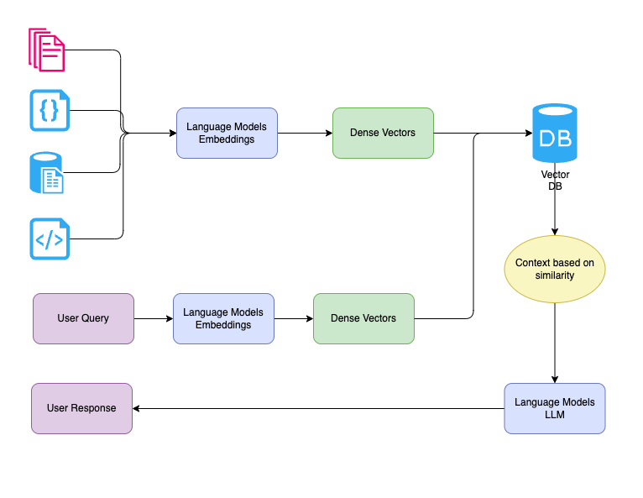
RAG Workflow

Slide 44
Practical Implementation

Slide 45
Thank you
Follow me on
M K Pavan Kumar – Medium
(26) Pavan Mantha | LinkedIn

